Slide 1

Cognitive Labs
Lab 4: Watson Visual Recognition

Slide 2
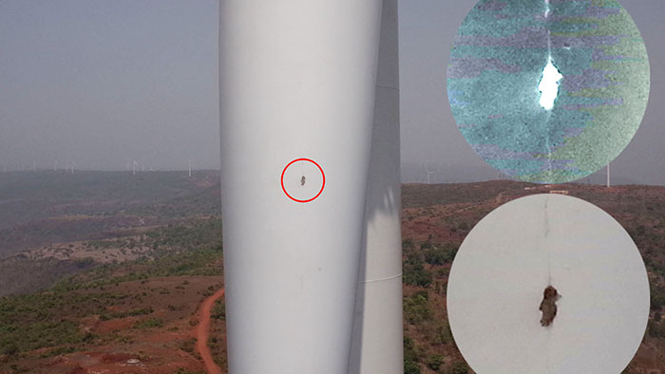
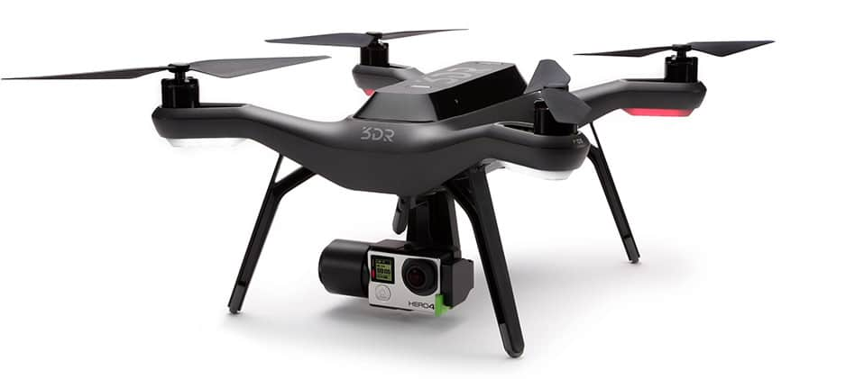
Objective
Create a dashboard app that can identify objects and content within images
uses the supplied Watson Visual Recognition general model
Build a simulated drone inspection application that looks for cracks in buildings / infrastructure
uses a custom Watson Visual Recognition machine learning model
Watson Visual Recognition
IBM Cloud Object Storage
Node-RED
dashboard UI, mapping

Slide 3
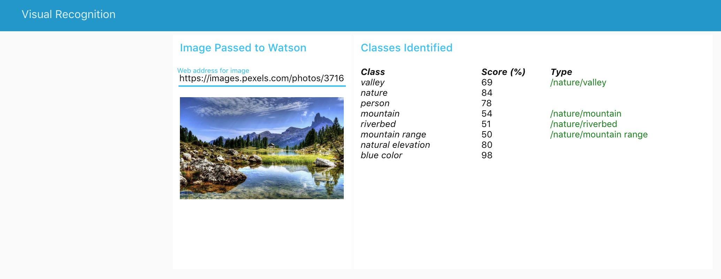
Objective

Slide 4
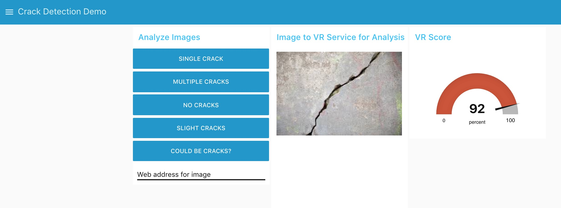
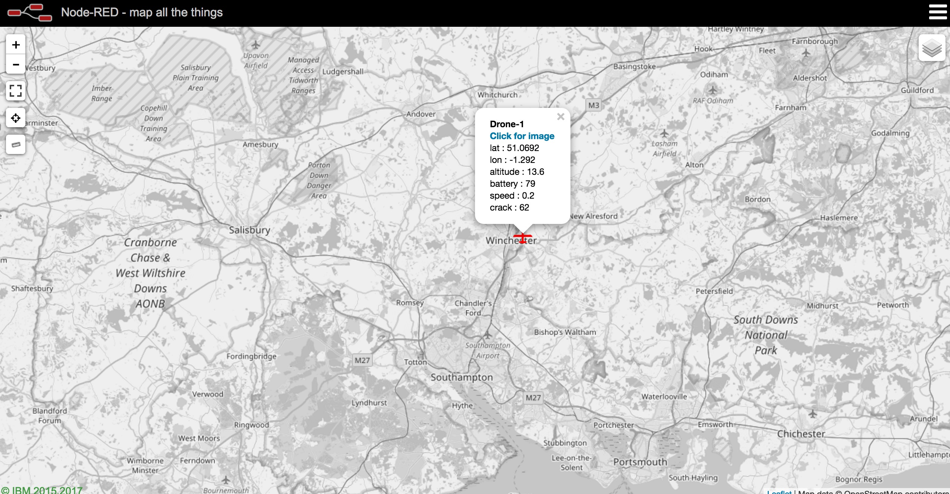
Objective

Slide 5
Agenda
setup Visual Recognition and Object Storage instances in IBM Cloud
create a Node-RED flow to classify and display web images using Node-RED dashboarding
use Watson Studio to train a custom Visual Recognition classifier
create Object Storage repository and upload test images
import and customise the basic 'drone inspection' Node-RED flow
run and test your application
extend the app by adding a web URL input capability and a mapping service

Slide 6

What is the Visual Recognition service?
The Watson Visual Recognition service uses deep learning algorithms to analyze images for scenes, objects, faces, and other content.
Built-in classes provide highly accurate results without training
General model: Default classification from thousands of classes
Face model: Facial analysis with age and gender
Explicit model: Whether an image is inappropriate for general use
Food model: Specifically for images of food items
Text model: Text extraction from natural scene images
Train custom classifiers and collections using your own images

Slide 7
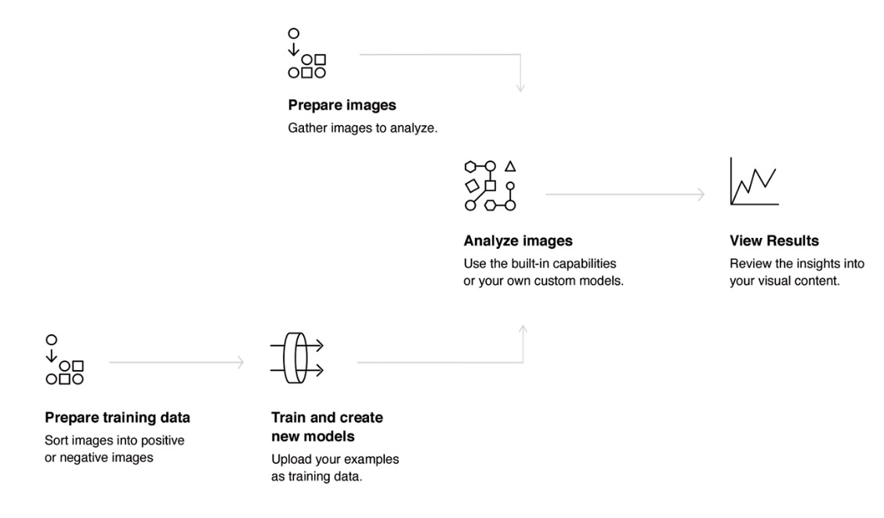
Using the Visual Recognition service

Slide 8
Training Guidelines
Limitations
Supported formats: JPEG, PNG
Maximum size for image scoring: 10 MB
Limitations of zip file: 100 MB, 10,000 images, min 10 images
Max 256 MB zip file per training call
Recommendations
At least 50 images per class/negative
preferably 150–200 images per .zip file for best balance between processing time and accuracy
benefits of training a classifier plateaus at around 5000 images
Similar numbers of positive/negative images
Images should be at least 224x224 pixels

Slide 9
Visual Recognition use cases
The Visual Recognition service can be used for diverse applications and industries
Manufacturing: Use images from a manufacturing setting to make sure products are being positioned correctly on an assembly line
Insurance: Rapidly process claims by using images to classify claims into different categories
Social listening: Use images from your product line or your logo to track buzz about your company on social media
Social commerce: Use an image of a plated dish to find out which restaurant serves it and find reviews, use a travel photo to find vacation suggestions based on similar experiences
Retail: Take a photo of a favourite outfit to find stores with those clothes in stock or on sale, use a travel image to find retail suggestions in that area
Education: Create image-based applications to educate about taxonomies
Visual auditing: Look for visual compliance or deterioration in a fleet of trucks, planes, or windmills out in the field, train custom models to understand what defects look like

Slide 10
Cognitive Labs
Lab 4: Watson Visual Recognition

